Slide 1
Kanban

Slide 2
What is Kanban?
A visual system for managing work as it moves through a process.
Not a process, but a system of values, like SCRUM.
Reducing the “currently running work”.
More "flexible" methodology than SCRUM:
- there are not time boxes (neither for tasks and sprints);
- there are more tasks and less of them;
- estimates of the timing for tasks are optional or missing "Team speed" is
absent, the average time for the full implementation of the task is considered.

Slide 3
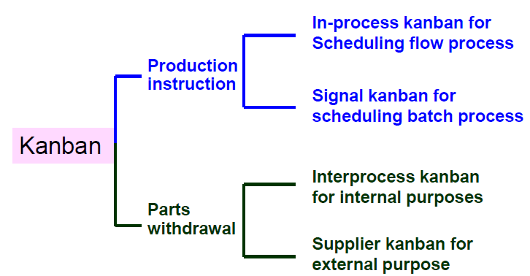
Types of Kanban Systems

Slide 4
How does Kanban work?
Visualize the workflow:
- split the work into pieces, write each item on a card and put on the wall;
- use named columns to illustrate where each item is in the workflow.
Limit WIP (work in progress) – assign explicit limits to how many items
may be in progress at each workflow state.
Measure the lead time (average time to complete one item, sometimes
called “cycle time”), optimize the process to make lead time as small and
predictable as possible.

Slide 5
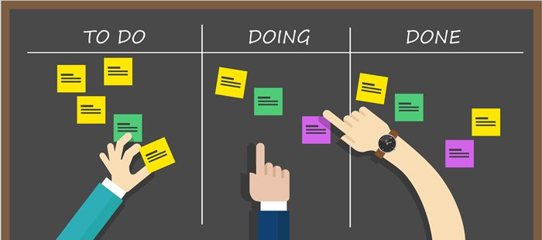
The Concept
Kanban is a non-disruptive evolutionary change management system.

Slide 6
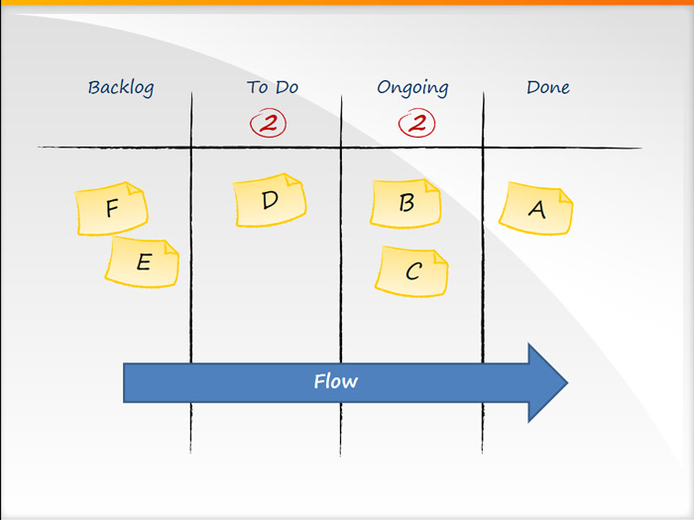
The concept of FLOW
At the core of Kanban is the concept of “Flow”. This means that the cards
should flow through the system as evenly as possible, without long waiting
times or blockages.

Slide 7

Kanban WIP Limits
A key aspect of Kanban is to reduce the amount of multi-tasking that most
teams and knowledge workers are prone to do and instead encourage them
to “Stop Starting! And Start Finishing!”

Slide 8
Kanban process

Slide 9
What are the benefits of Kanban?
Some commonly observed benefits are:
Flexibility
Focus on continuous delivery
Reduction of wasted work / wasted time
Increased productivity
Increased efficiency
Team members’ ability to focus

Slide 10
Thank you!

